Slide 1

Classification Techniques and Methodology for Heart Disease Prediction
PROG8510 – Programming Statistics for business

Slide 2

Team Members
Keval Harkhani - 8761543
Kunal Sevak - 8817782
Piyush Jinjala - 8740299
Pulkit Saluja – 8814608
Shravya Shetty - 887899

Slide 3
Problem Statement
The health care industries collect huge amounts of data that contain some hidden information, which is useful for making effective decisions. For providing appropriate results and making effective decisions on data, some advanced data mining techniques are used.
In this study, an effective heart disease prediction system (EHDPS) is developed using various classification techniques for predicting the risk level of heart disease.

Slide 4
Abstract
In this project we will try to establish relationship and knowledge between various medical factors related to heart disease and patterns to be established.
We will implement various classification techniques and algorithms for training and testing purpose to effectively predict the risk level of heart disease.

Slide 5
Dataset Description & Preparation
The system uses 18 medical parameters such as age, sex, blood pressure, cholesterol, BMI, Smoking, Alcohol, physical health, mental health, race and obesity for prediction.
We have in total 9 Boolean Variables, 5 Strings and 4 numeric values.
We will be using effective classification techniques to predict the likelihood of patients getting heart disease.

Slide 6
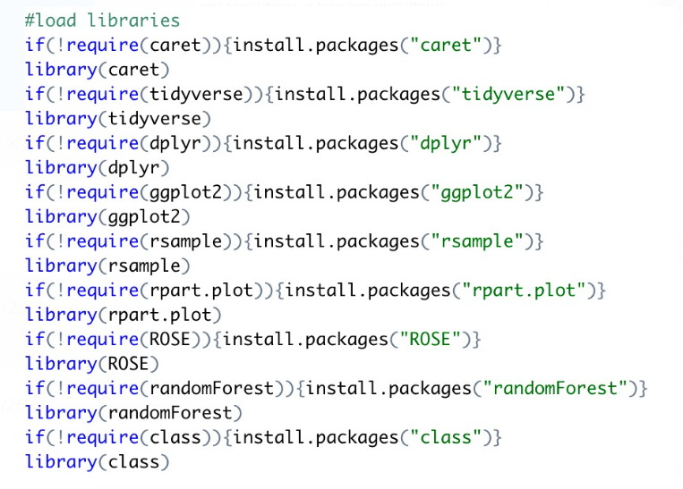
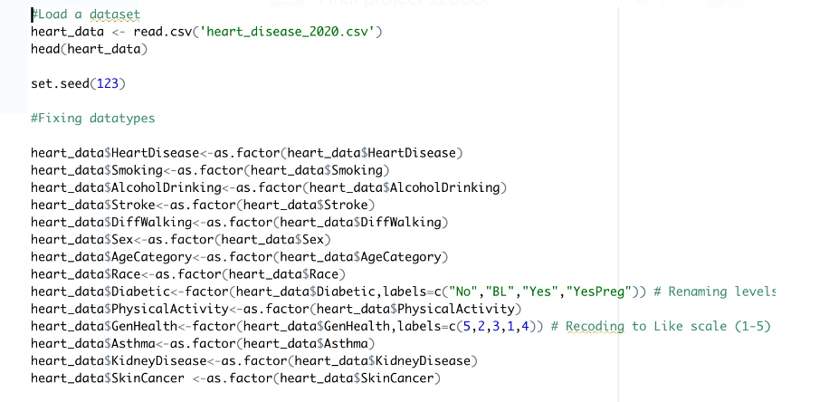
Dataset Description & Preparation
Libraries and Categorization of Data in R Studio

Slide 7
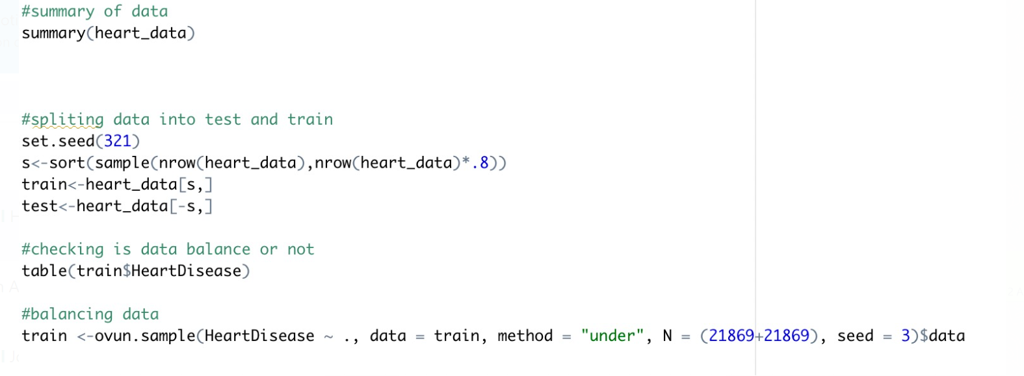
Dataset Description & Preparation
Training and Testing Data

Slide 8
Classification Techniques used for Predictions
KNN Algorithm & Generalized Linear Model
Decision Tree & Random Forrest
Regularization with Lasso and Ridge
Deep Learning - NLP

Slide 9
KNN Algorithm & Generalized Linear Model
The k-nearest neighbors (KNN) algorithm is a simple, supervised machine learning algorithm that can be used to solve both classification and regression problems. It's easy to implement and understand.
K-NN is a non-parametric algorithm, which means it does not make any assumption on underlying data.
The term "general" linear model (GLM) usually refers to conventional linear regression models for a continuous response variable given continuous and/or categorical predictors.
Glm is used to fit generalized linear models, specified by giving a symbolic description of the linear predictor and a description of the error distribution.

Slide 10
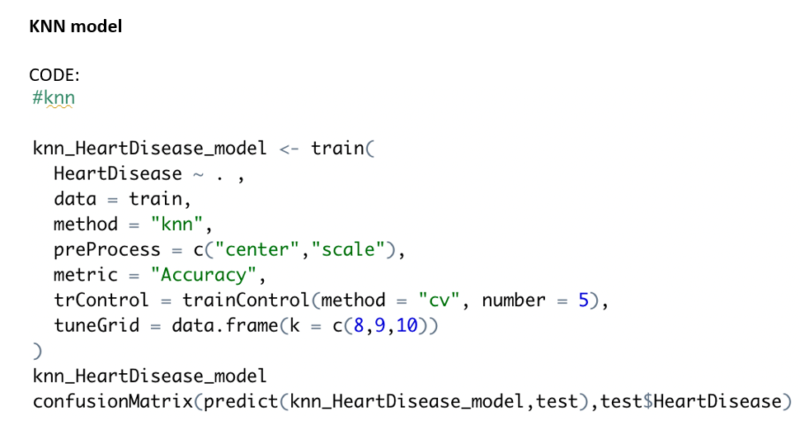
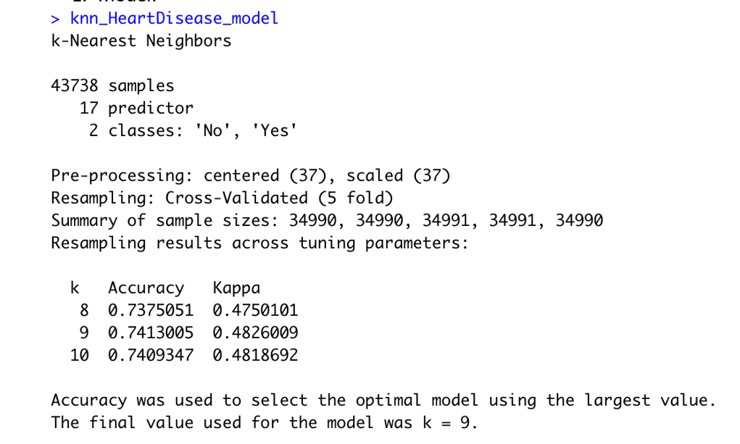
KNN Algorithm & Generalized Linear Model
KNN Method Prediction Technique

Slide 11
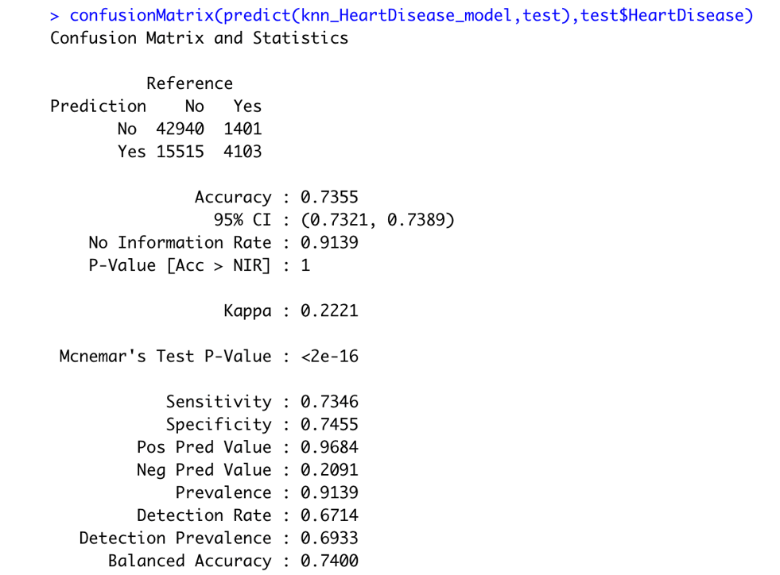
KNN Algorithm & Generalized Linear Model
KNN Method Prediction technique – Confusion Matrix

Slide 12
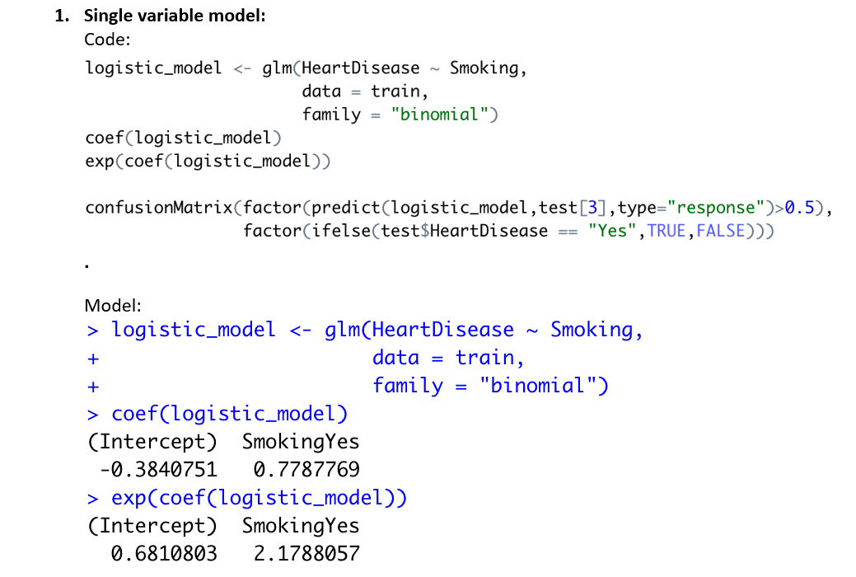
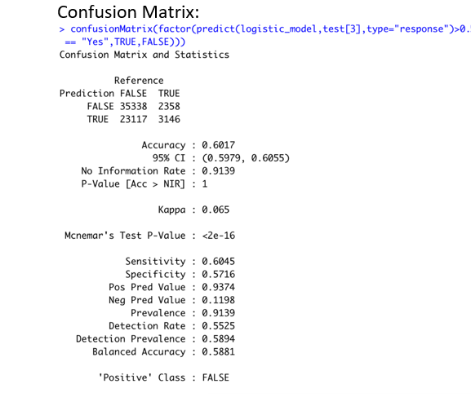
KNN Algorithm & Generalized Linear Model
GLM Method Prediction technique with Single Variable

Slide 13
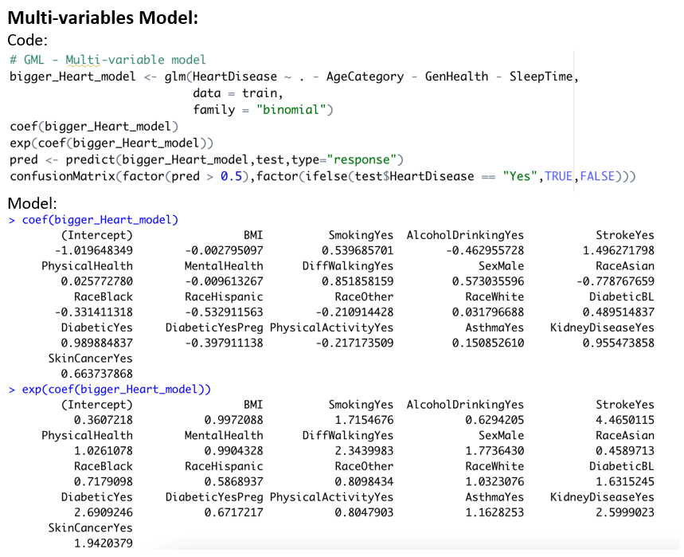
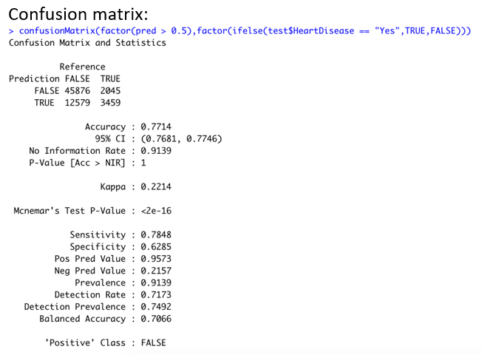
KNN Algorithm & Generalized Linear Model
GLM Method Prediction technique with Multiple Variable

Slide 14
Decision Tree & Random Forrest
A decision tree is a type of supervised machine learning used to categorize or make predictions based on how a previous set of questions were answered.
The model is a form of supervised learning, meaning that the model is trained and tested on a set of data that contains the desired categorization.
The random forest is a classification algorithm consisting of many decisions trees. It uses bagging and feature randomness when building each individual tree to try to create an uncorrelated forest of trees whose prediction by committee is more accurate than that of any individual tree.

Slide 15
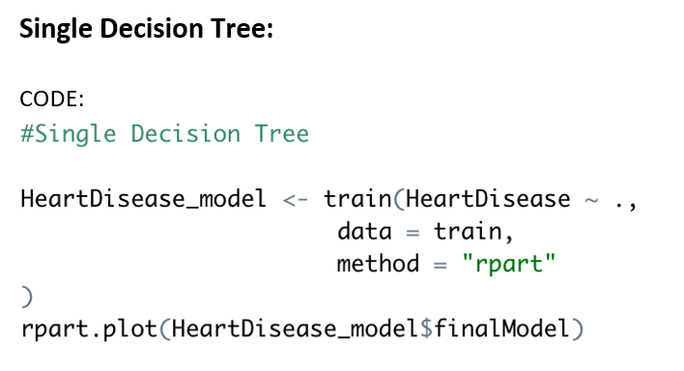
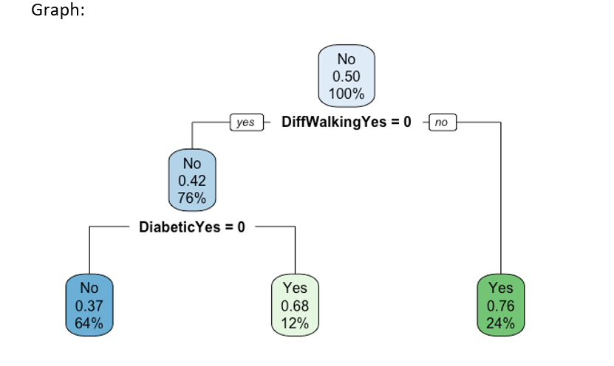
Decision Tree & Random Forrest
Single Decision Tree

Slide 16
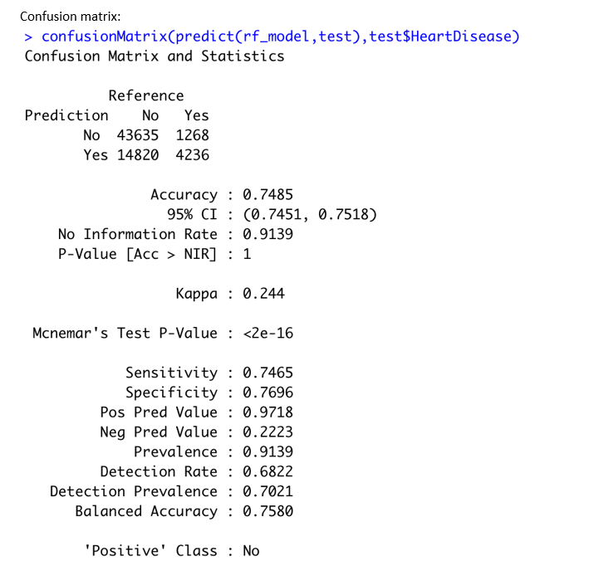
Decision Tree & Random Forrest
Single Decision Tree – Confusion Matrix

Slide 17
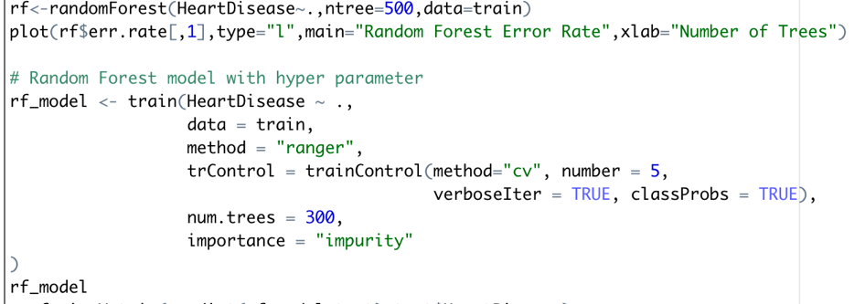
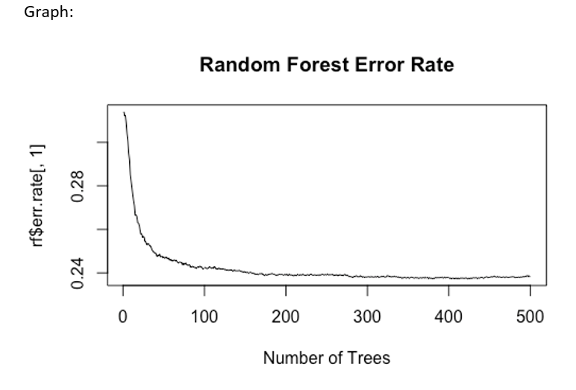
Decision Tree & Random Forrest
Random Forrest

Slide 18
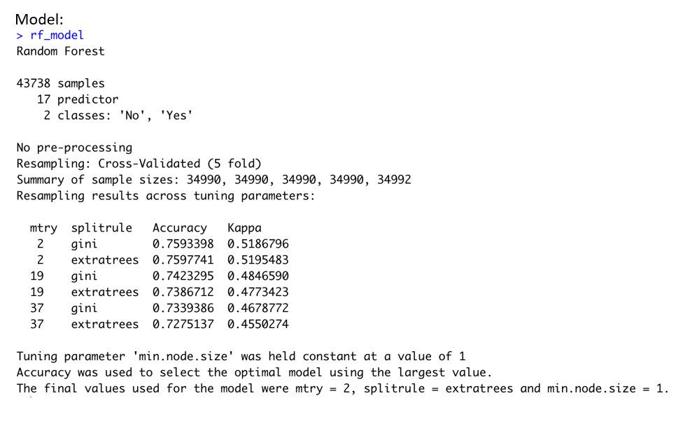
Decision Tree & Random Forrest
Random Forrest – Analysis

Slide 19
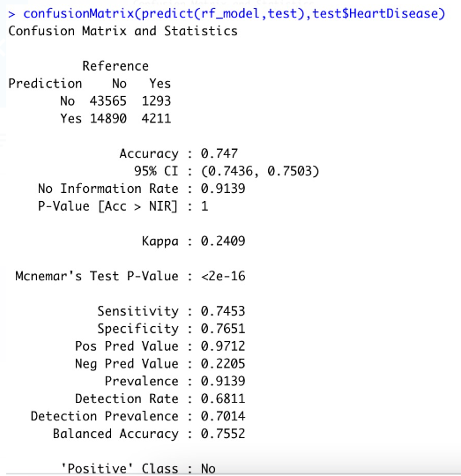
Decision Tree & Random Forrest
Random Forrest – Confusion Matrix

Slide 20
Regularization with Lasso and Ridge
Regularization is one of the ways to improve our model to work on unseen data by ignoring the less important features.
Regularization minimizes the validation loss and tries to improve the accuracy of the model.
It avoids overfitting by adding a penalty to the model with high variance, thereby shrinking the beta coefficients to zero.
There are two types of regularization:
Lasso Regularization
Ridge Regularization

Slide 21
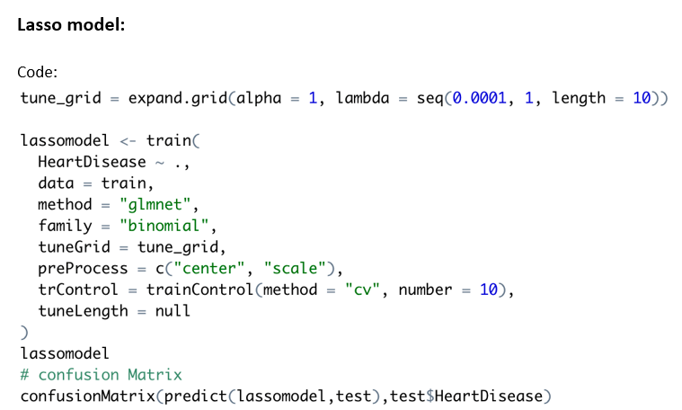
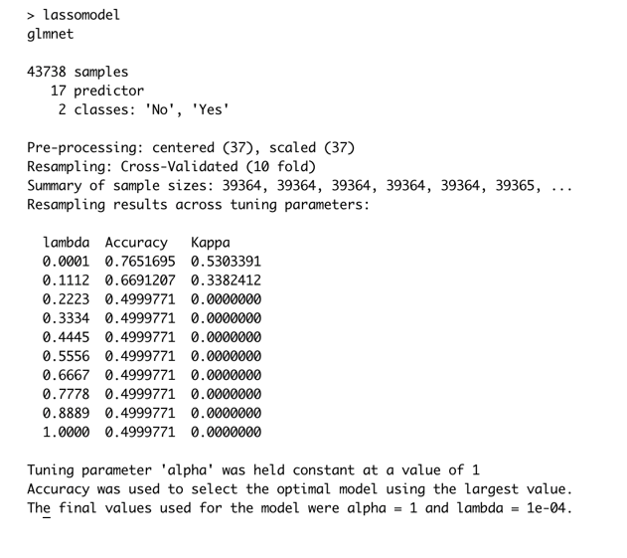
Regularization with Lasso and Ridge
Lasso Model

Slide 22
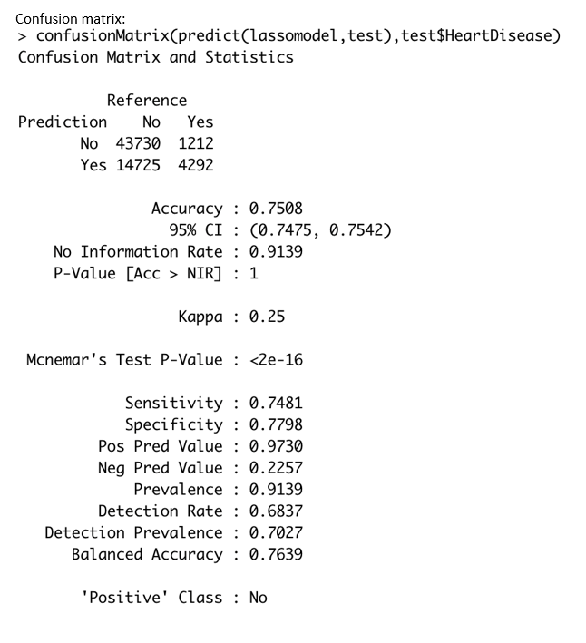
Regularization with Lasso and Ridge
Lasso Model – Confusion Matrix

Slide 23
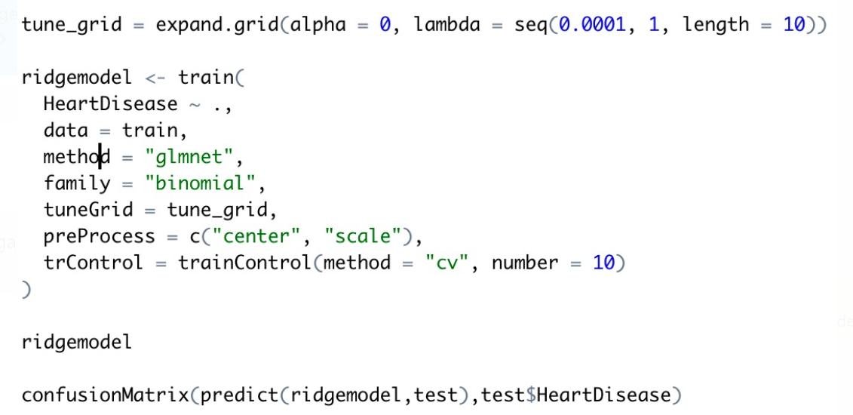
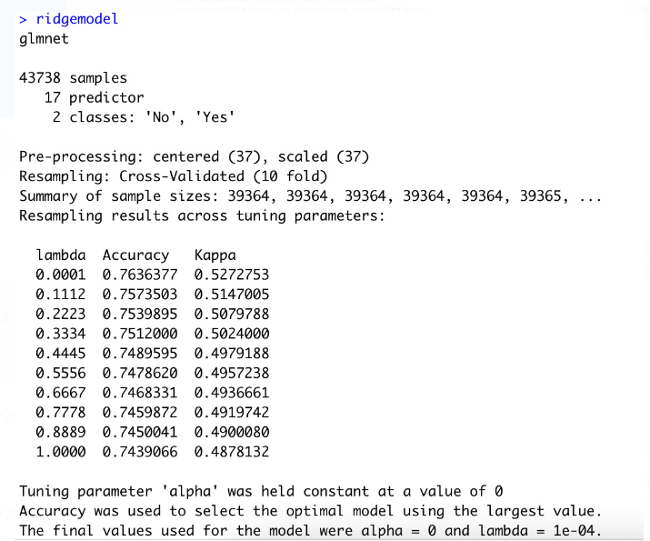
Regularization with Lasso and Ridge
Ridge Model

Slide 24
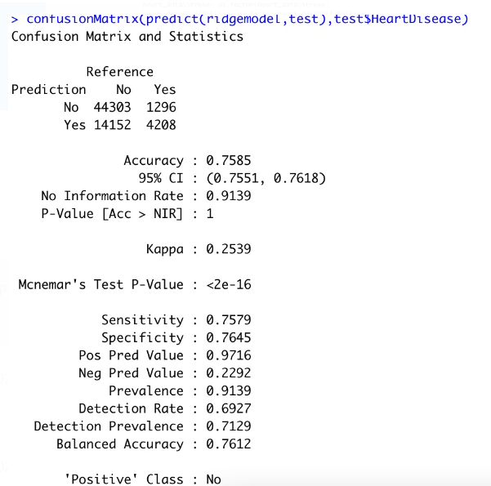
Regularization with Lasso and Ridge
Ridge Model – Confusion Matrix

Slide 25
Deep Learning - NLP
Deep learning is a type of machine learning and artificial intelligence (AI) that imitates the way humans gain certain types of knowledge. Deep learning is an important element of data science, which includes statistics and predictive modeling.
Here, the mathematical algorithms are combined with a lot of data and strong hardware to get qualified information.
The ability to process large numbers of features makes deep learning very powerful when dealing with unstructured data.

Slide 26
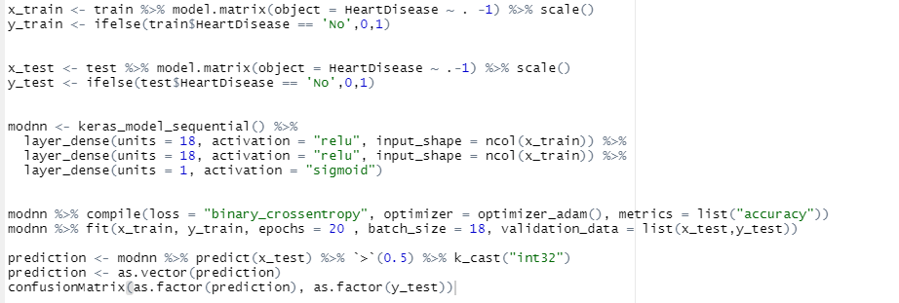
Deep Learning - NLP
Deep Learning - NLP

Slide 27
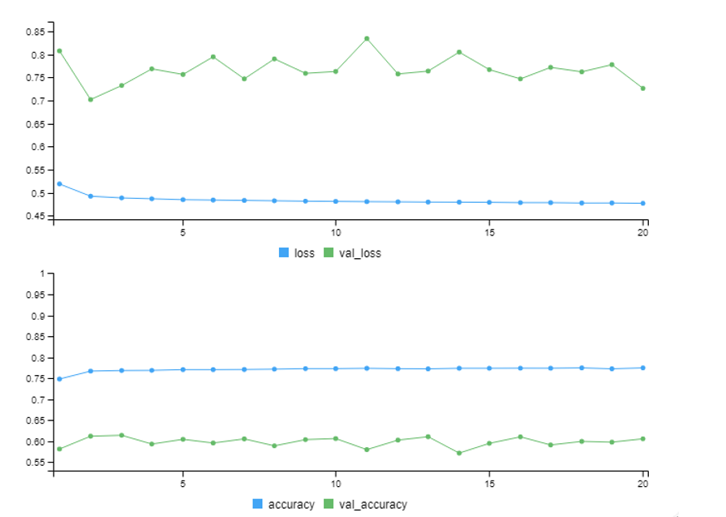
Deep Learning - NLP
Deep Learning - NLP

Slide 28
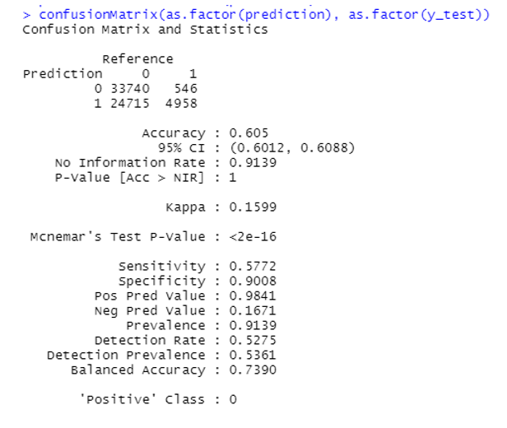
Deep Learning - NLP
Deep Learning - Confusion Matrix

Slide 29
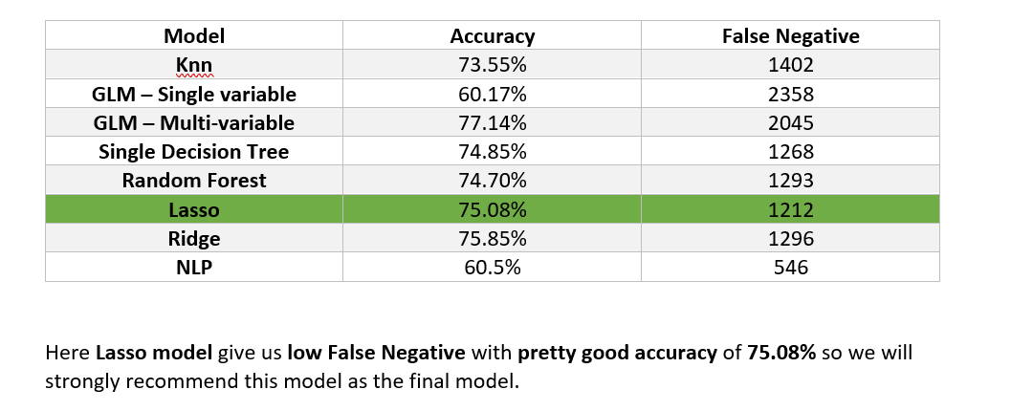
Learnings & Conclusions

